Slide 1
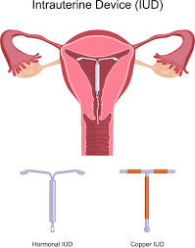
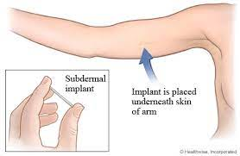
We fit LARC’s here!
What are
Long
Acting
Reversible Contraceptives?
Intra-Uterine Devices
Sub Dermal Implant
Hormonal Coil
Copper Coil
Speak to a nurse or visit www.ContraceptionChoices.org.uk

